Slide 1
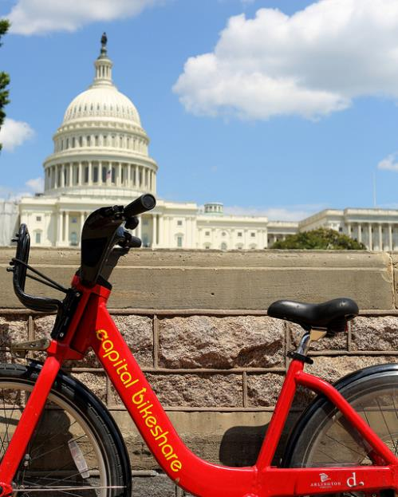
Capital Bikeshare
Melinda Wiley, Caylon Thomas, Kwasi Yeboah-afihene, and Sarah Christensen

Slide 2
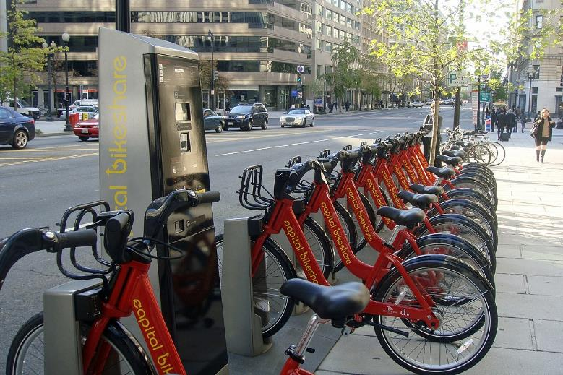
Capital Bikeshare over the Years
Analysis of Capital Bikeshare
Our core message: to see how Capital Bikeshare has grown over years – from 2010 to 2018-current
Questions:
Member type – Casual & Member; usage over time
Bike dock stations/ terminal build out - Addition and removal of docks between 2010-2018
Are there peaks times (Years, Months, Times during the day)?
Which terminals are used the most vs not used very often?
Utilized datasets
OpenData DC Gov – Capital Bike Share Locations
Capital Bikeshare System Data
This Photo by Unknown Author is licensed under CC BY-SA

Slide 3
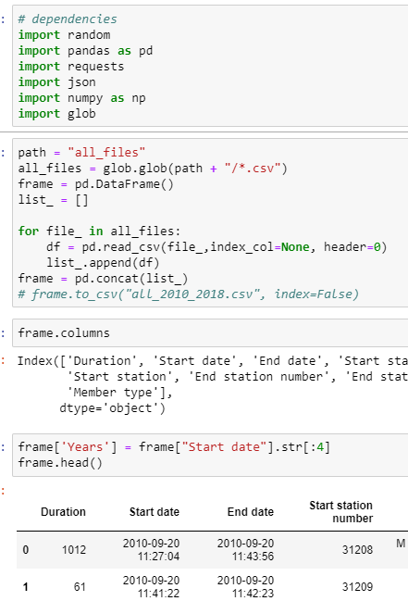
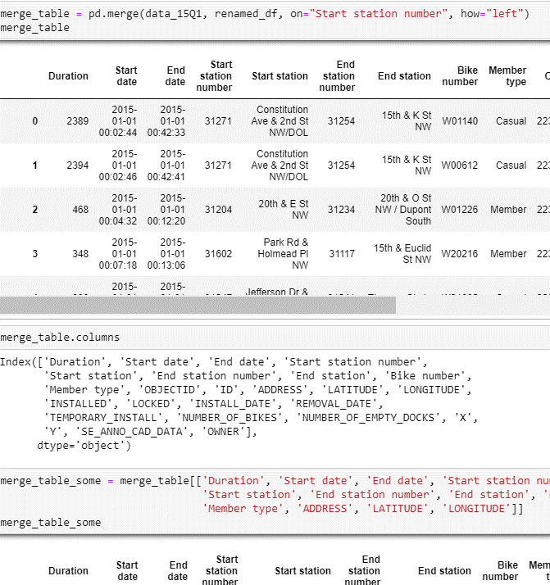
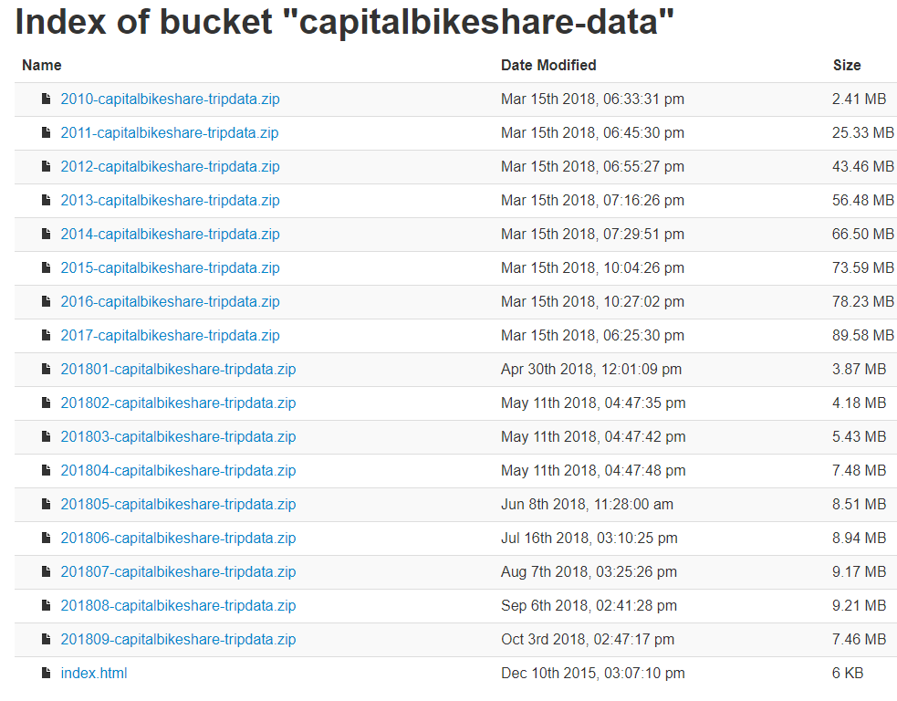
Datasets – merging/joins/concat

Slide 4
Peaks and Usage
Peak Times (Month, Time, Year) And Terminal Visits
Questions & Data
Are there noticeable peaks?
One goal was to see if we could tell if there has been an impact with the introduction of scooters
Data
Capital Bikeshare System Data
OpenData DC
Data Cleanup & Exploration
Studying the cvs
Outlines
Small bits at a time
Didn’t anticipate – such large datasets vs smaller workable samples
Sample sets vs full dataset
Problem – date data
Data Analysis
Trial and error
Small bits at a time to get the code correct
Any impact with the introduction of scooters
Findings
That Capital Bikeshare has been successful since its start in DC
Peak times during the day – start of work day and end of work day
Most popular stations – guess it would be tourist locations

Slide 5
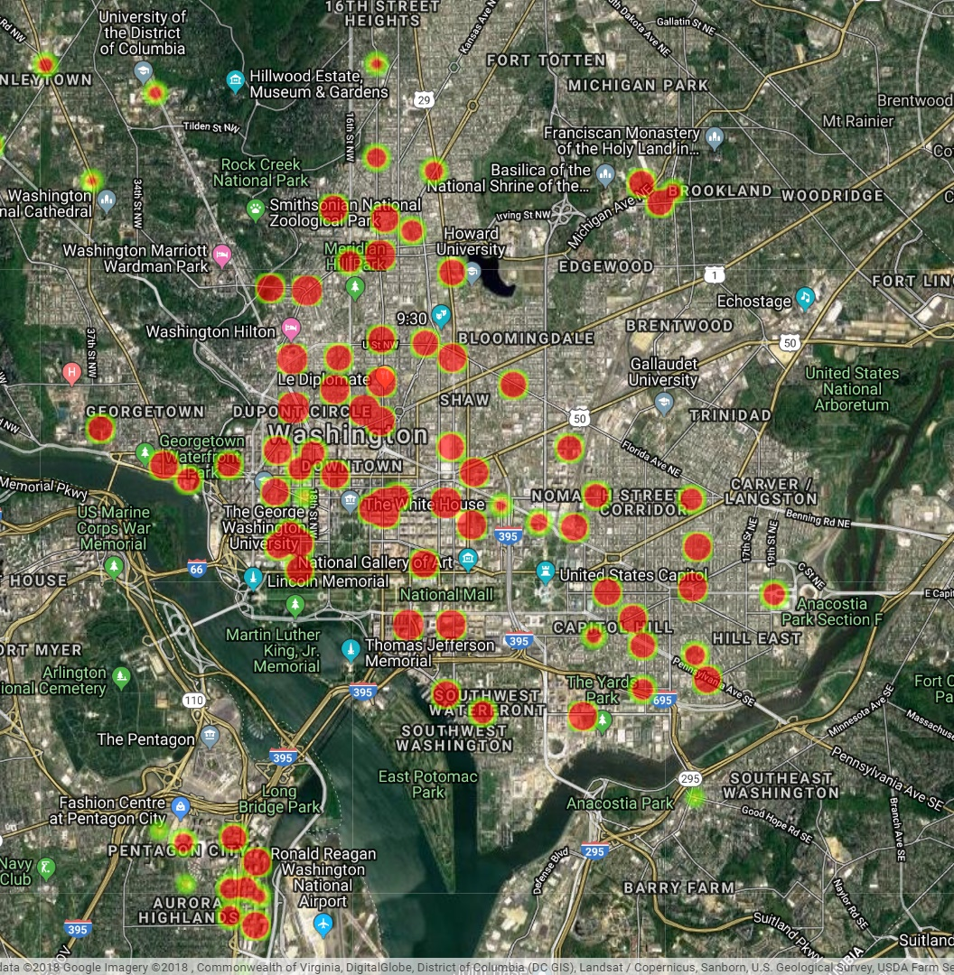
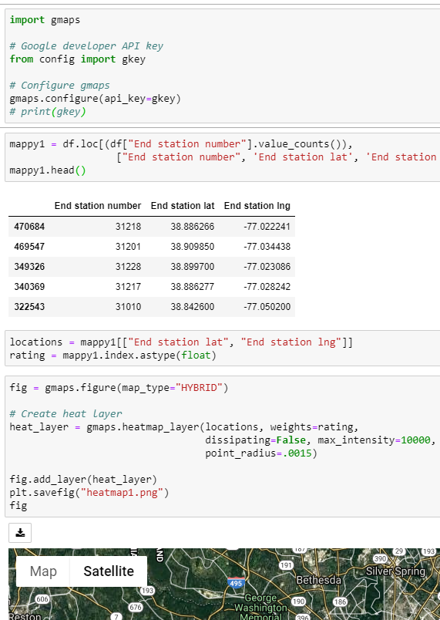
Terminals Visited Heatmap

Slide 6
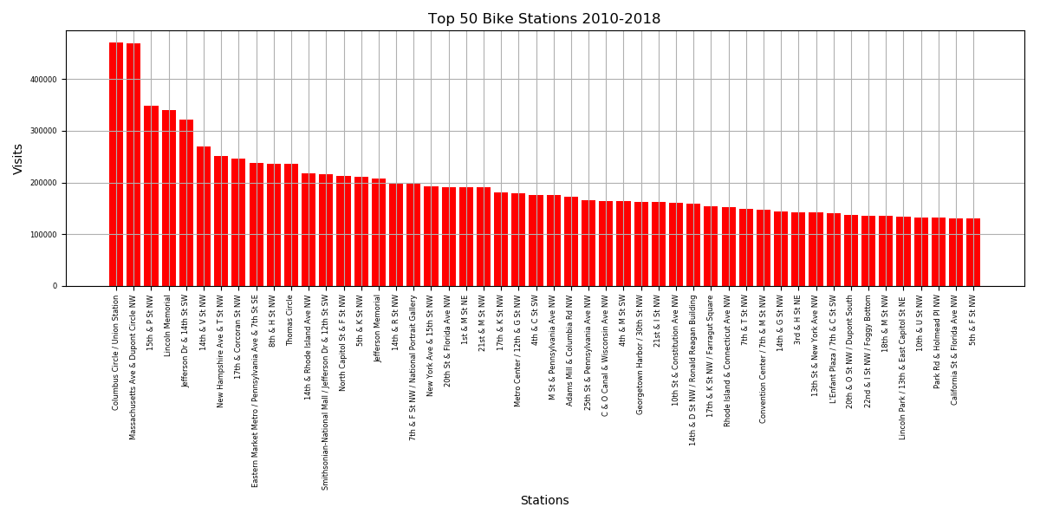
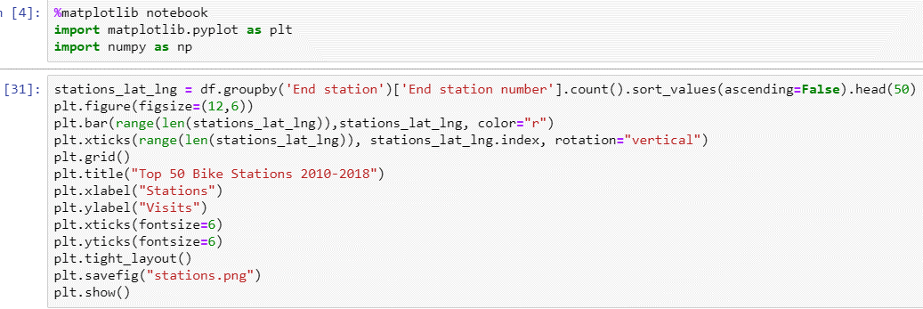

Slide 7
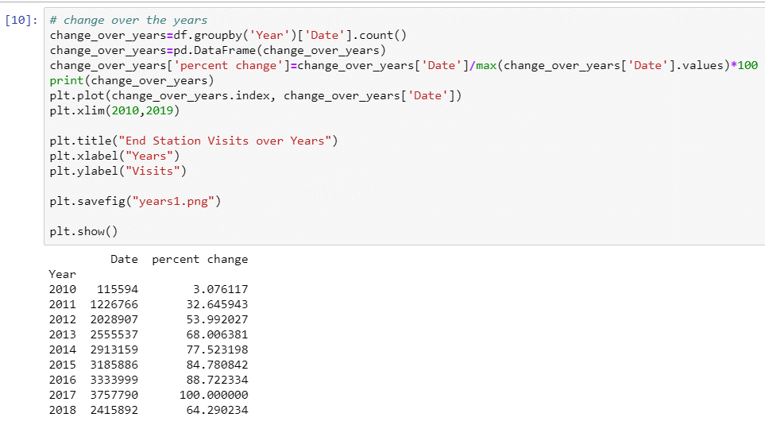
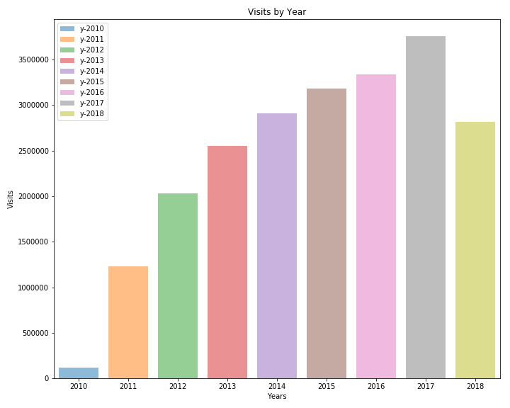
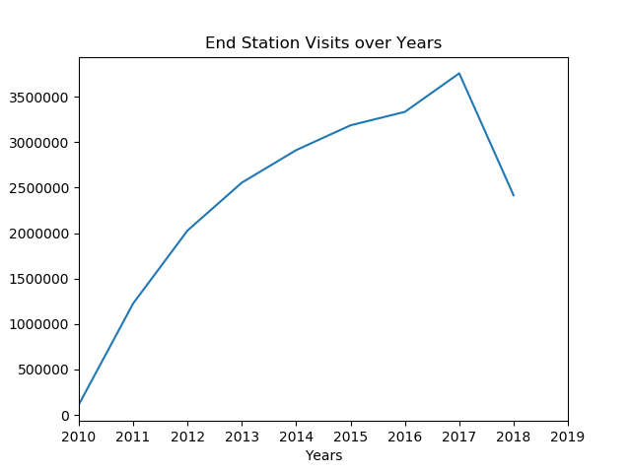
Over the Years

Slide 8
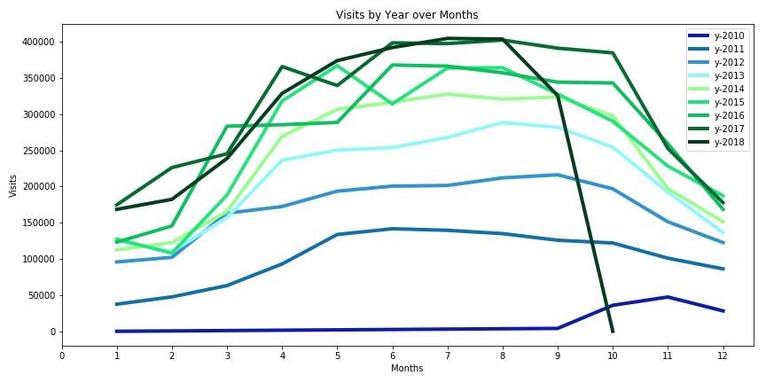
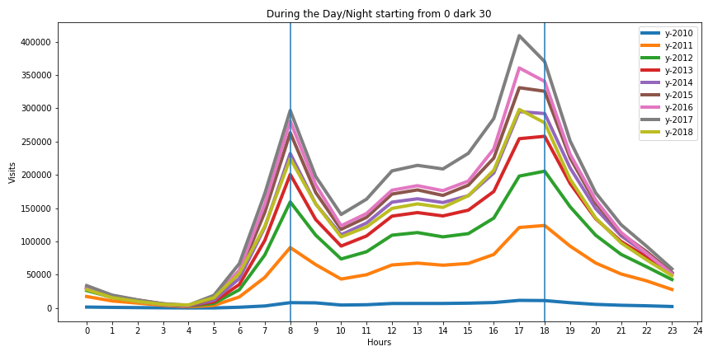
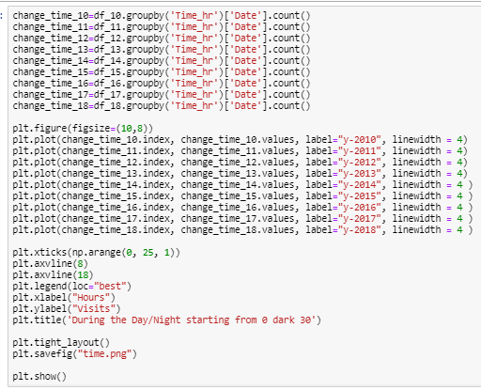
Time and Months

Slide 9
Member type - Kwasi
Questions
Which member type has the highest level of usage on the average per year?
Which member type dominates the biker population of capital bike share
Data source: Capital Bike Share data from 2010 – 2018
Random Sample Size: 40000 per year except 2018, which had a sample size of 30000 records
Analysis
Performed a nested groupby: [Year, Member type] and summarized the data by finding the mean duration for the first question.
Performed a nested groupby: [Year, Member type] and summarized the data by counting the duration variable.
Drew a line graph for both
Related code snippets:
Q 1
newgroup = bike_file_one_df.groupby(['Year', 'Member type']).mean()['Duration'].unstack().plot()
newgroup.set_ylabel("Mean Usage Per Second")
newgroup.set_xlabel("Year")
plt.savefig("Pie_Fig_19.png")
plt.show()
Q2
newgroup = bike_file_one_df.groupby(['Year', 'Member type']).count()['Duration'].unstack().plot()
newgroup.set_ylabel("Count of Member Type")
newgroup.set_xlabel("Year")
plt.savefig("Pie_Fig_20.png")
plt.show()

Slide 10
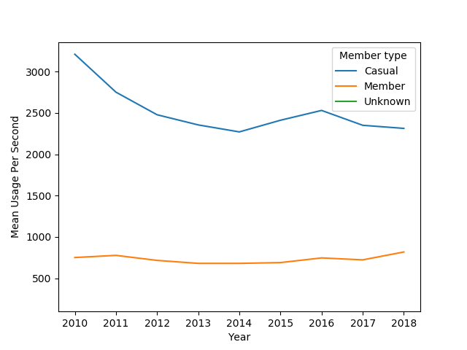
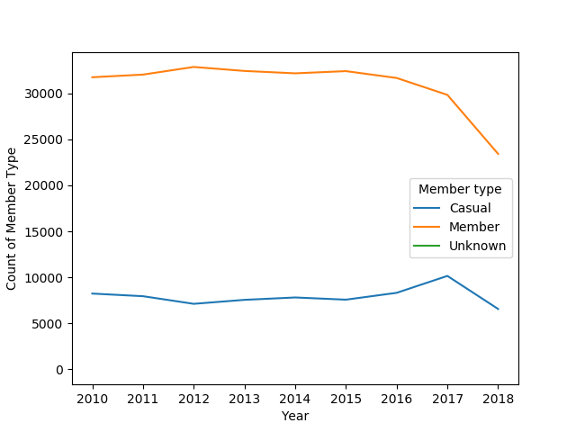
Member Type - Kwasi ‘Findings and Conclusion’
Casual users on the average use the bikes for a longer period of time than Members
The usage level of casual users is trending down from 2010 to 2018
The members are about 3/4 of the biker population of Capital Bike Share
The casual users are about 1/3 of the biker population
Note: Only 3 quarters of data was reported in 2018, Hence 3000 records were randomly selected. [10000 samples were randomly selected per quarter]

Slide 11
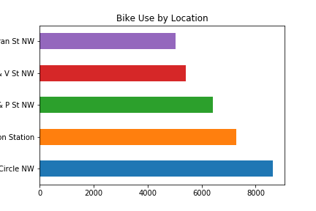
Sarah – Use 2013-2018
Most used bikeshare locations 2013 – 2018
3 located near Dupont Circle, 1 near large metro hub, 1 near popular area by DC Mall
17th & Corcoran St NW
14th & V St NW
15th & P St NW
Columbus Circle/ Union Station
Massachusetts Ave & Dupont Circle NW

Slide 12
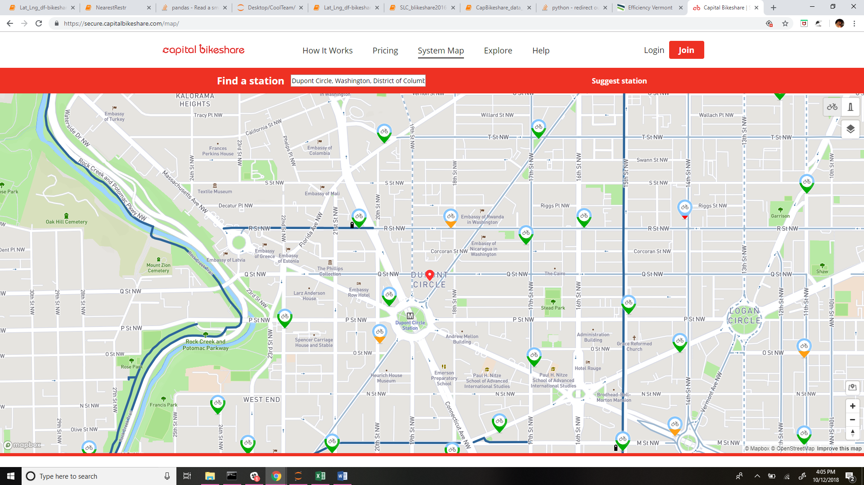
Sarah – Proximity of top 3/5
A: Massachusetts Ave & Dupont Circle NW
B: 17th & Corcoran St NW
C: 15th & P St NW
B
A
C

Slide 13
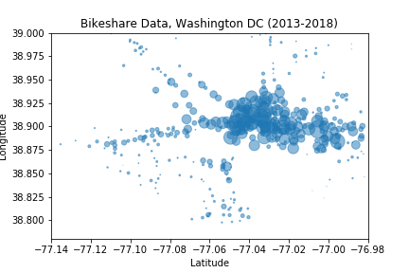

Sarah – Summary & Ideas
While the top 5 were near popular areas, thus projecting future areas this is less useful for, surprisingly there bottom 5 only have 1 use.
Given more time I would count these and look at their areas to determine where resources could be reduced, possibly re-allocated to the higher use locations.
I also began looking at the bikeshare locations over time and though didn’t see any large ridership anomalies to point out, though more time may reveal more.

Slide 14
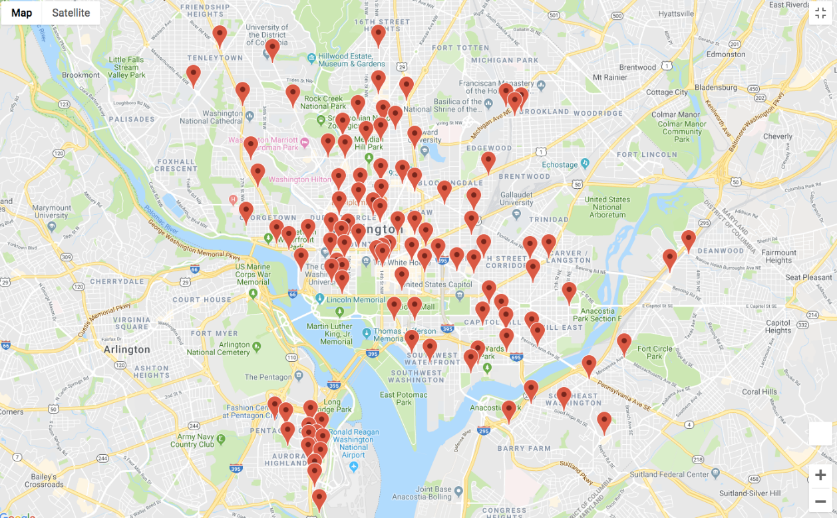
Dock stations - Caylon
Question:
What is the progression of Capital Bikeshare docks over an eight year period in the DC and Virginia metro area?
Data Sources:
Capital Bikeshare data sources (website)
DC government public data sources (website)
Data Cleanup & Exploration:
Large dataset merges
Large dataset appends
Duplicates removal
Geocoding
Notes:
* Describe the exploration and cleanup process
* Discuss insights you had while exploring the data that you didn't anticipate
* Discuss any problems that arose after exploring the data, and how you resolved them
* Present and discuss interesting figures developed during exploration, ideally with the help of Jupyter Notebook
* Data Analysis
* Discuss the steps you took to analyze the data and answer each question you asked in your proposal
* Present and discuss interesting figures developed during analysis, ideally with the help of Jupyter Notebook
* Discussion
* Discuss your findings. Did you find what you expected to find? If not, why not? What inferences or general conclusions can you draw from your analysis?

Slide 15
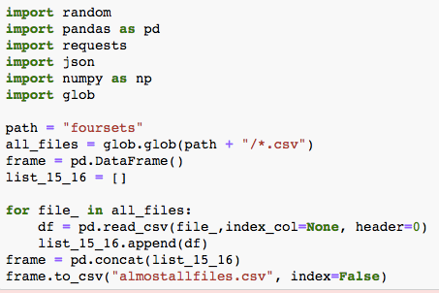
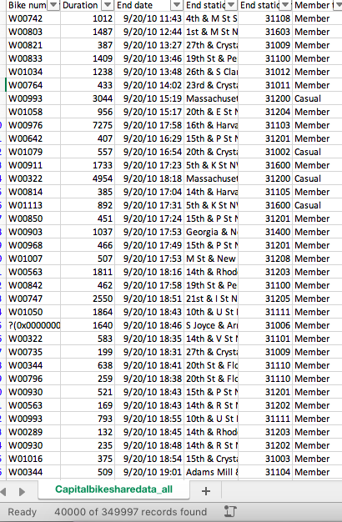
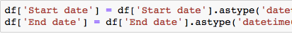
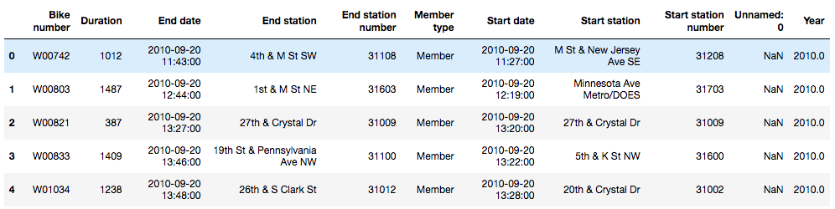
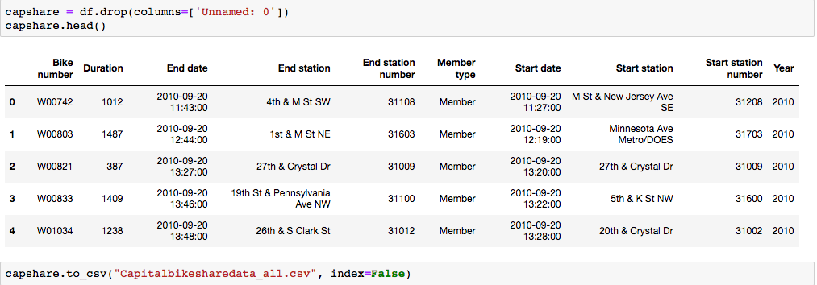
Example Code pt.1
1
Merging multi-year datasets, organizing date columns, and adding a year column
2
4
3

Slide 16
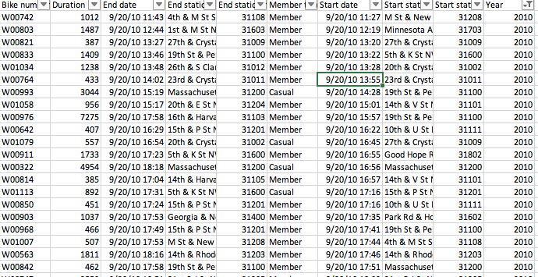
Example Code pt.2
1
CSV Data Cleanup sorted by year
2

Slide 17
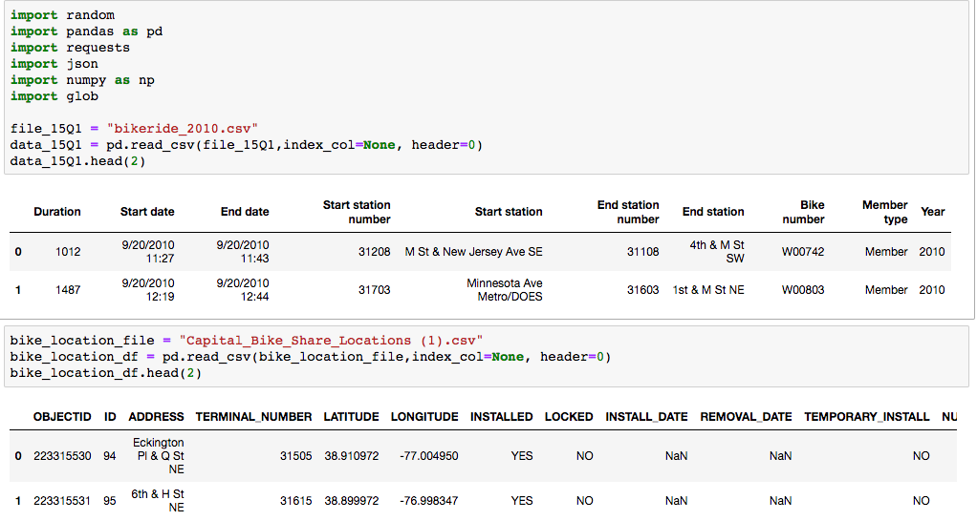
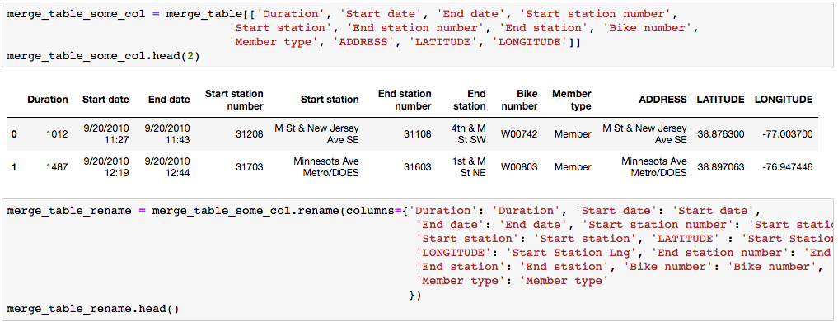
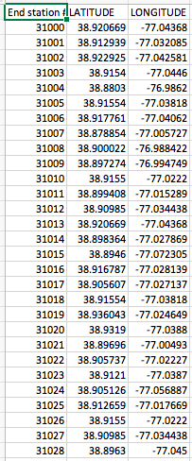
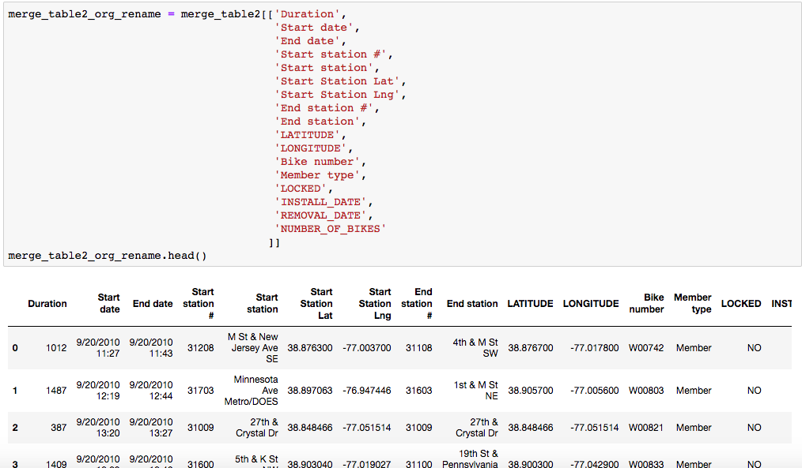
Example Code pt.3
1
2
4
Merging CSV’s to find the Long/Lat of a docking station by year
3

Slide 18
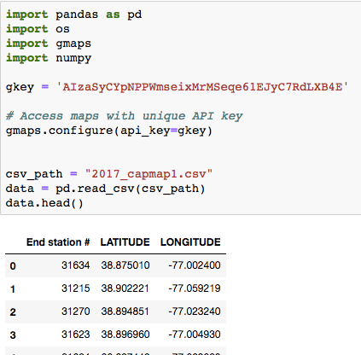
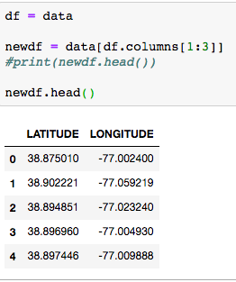
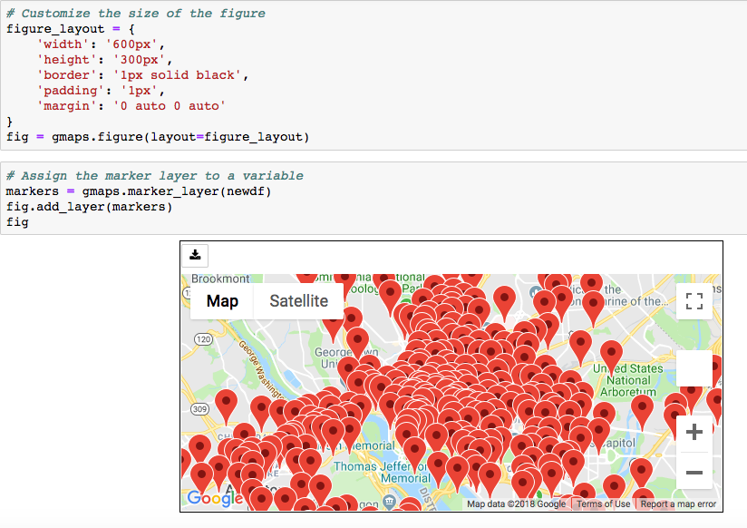
Example Code pt.4
1
2
3
Geocoding

Slide 19
Dock Progression
Addition of Docks over an 8 year period
2010 | 2011 | 2012 | 2013 | 2014 | 2015 | 2016 | 2017 | 2018
103 | 141 | 192 | 266 | 342 | 351 | 427 | 476 | 517

Slide 20
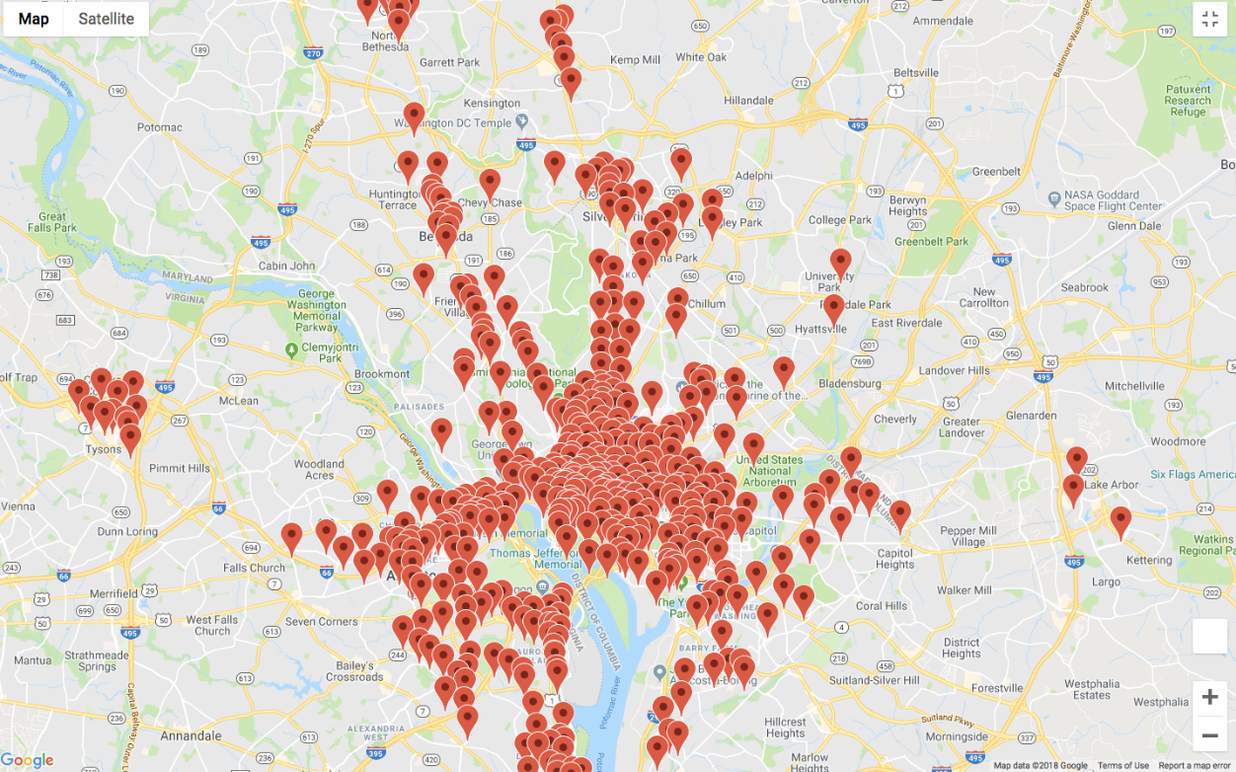
Finished Product
2010
2018
Docking stations

Slide 21
Questions
Discuss any difficulties that arose, and how you dealt with them
Discuss any additional questions that came up, but which you didn't have time to answer: What would you research next, if you had two more weeks?

